Slide 1
Simple solutions Profound results – changing attitudes through conservation
Nora Demers
Laurie Coventry-Payne
Florida Gulf Coast University
Fort Myers, FL

Slide 2
it was NOT simple! It IS profound!

Slide 3
Profound results – changing attitudes through conservation
EAST MULLOCH DRAINAGE DISTRICT

Slide 4
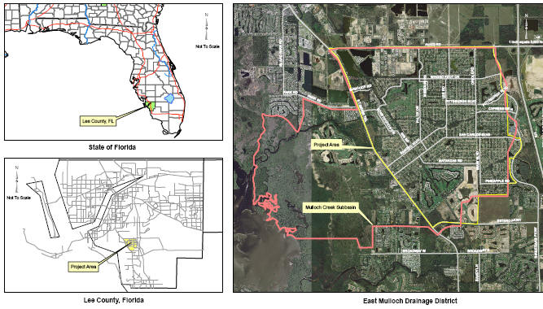
East Mulloch Drainage District

Slide 5
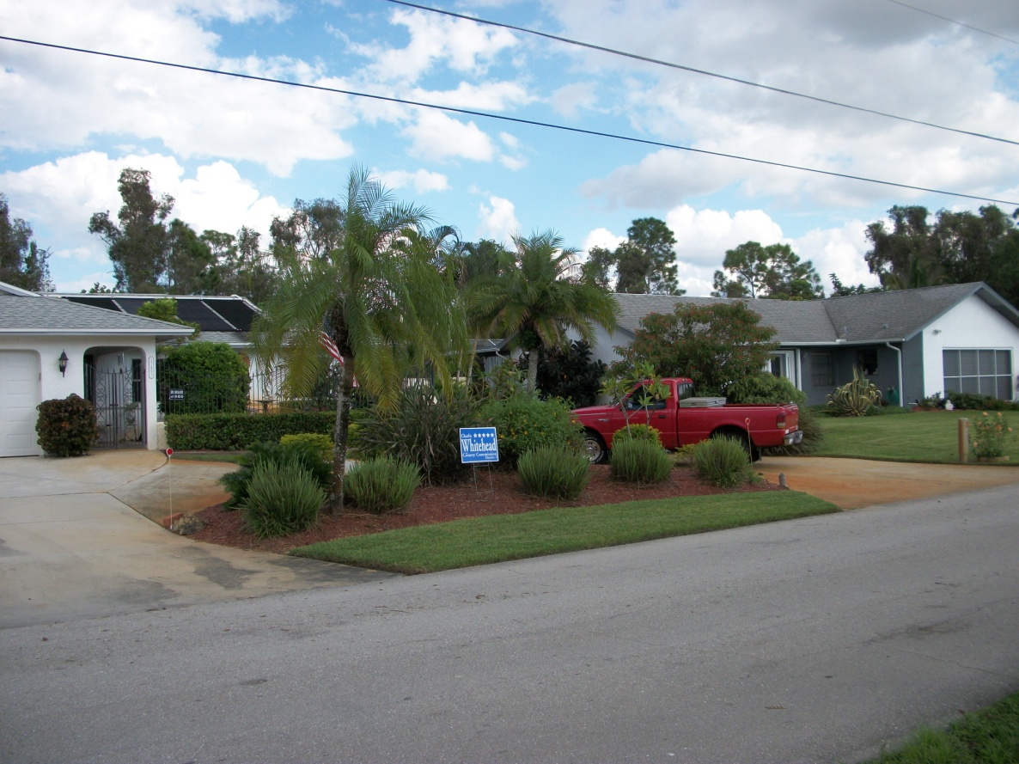
The scene
Pre-stormwater regulation community (1960’s)
Drainage District special funding unit by size not value of property- (only $70K/yr)
Straw ballot in 2006- 44% willing to pay more
(not knowing how much ‘more’ was)

Slide 6
Process
(at my request) County paid $180K for study to see what it would take to bring it to a state that they would be willing to ‘take it over’ (2008)
This is 3 years income for the district!
Estimate d $4M cost

Slide 7
Opportunity to incorporate my civic engagement with my professional career

Slide 8
University Colloquium at FGCU
REQUIRED OF ALL UNDERGRADS
Ecological Literacy
Sense of Place
Environmental education
Community engagement
Service-Learning requirement since 2006
10 hour equivalent
Project allows students to participate in an ‘authentic’ ongoing project

Slide 9
Profound results – changing attitudes through conservation
EAST MULLOCH DRAINAGE DISTRICT

Slide 10
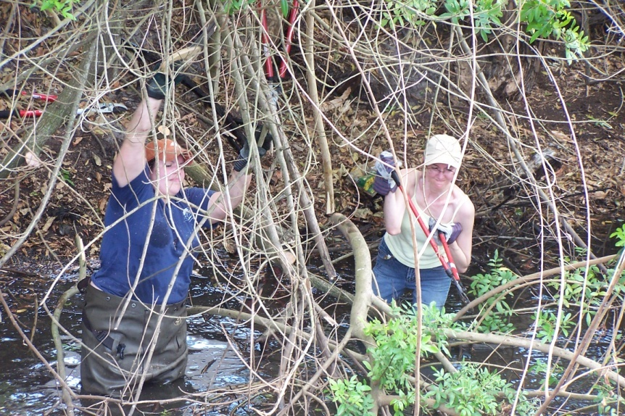
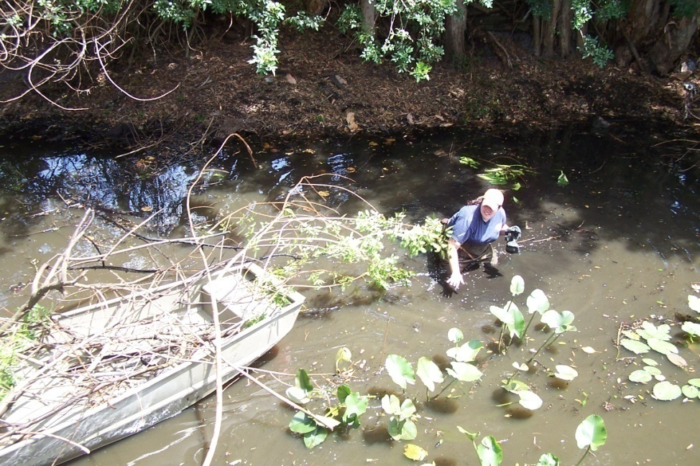
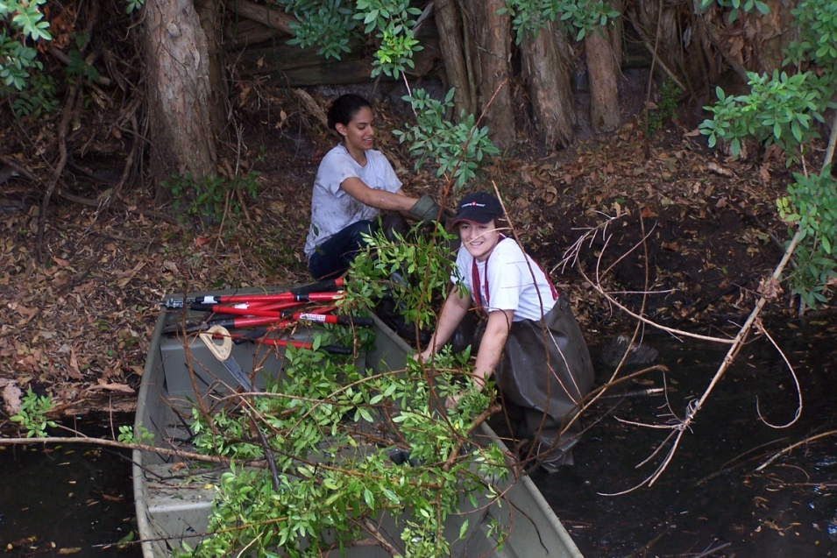
Mulloch Creek Habitat Shoreline Stabilization

Slide 11
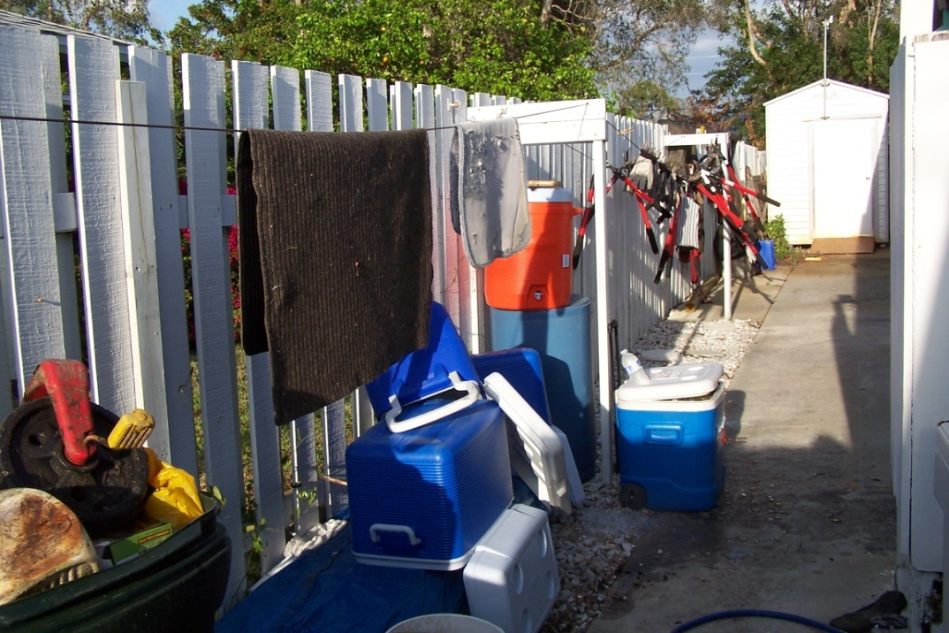
Habitat Restoration- trash removal

Slide 12
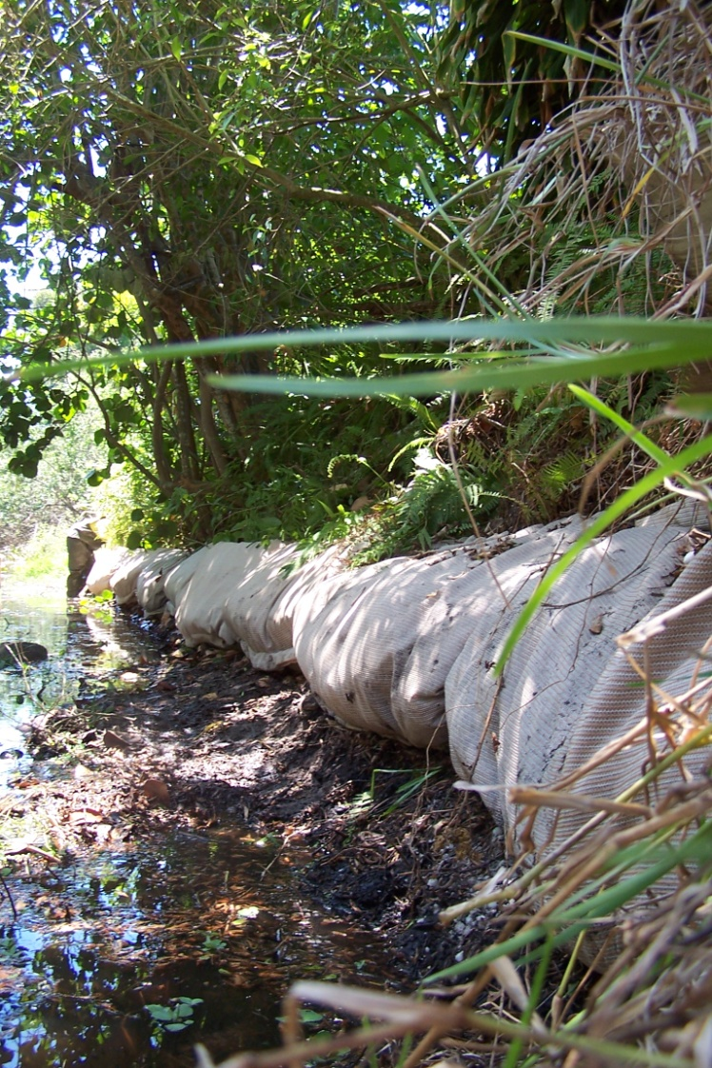
Mulloch Creek Habitat Shoreline Stabilization
54’ Corn-stalk filled SHORESOX installed
April, 2009

Slide 13
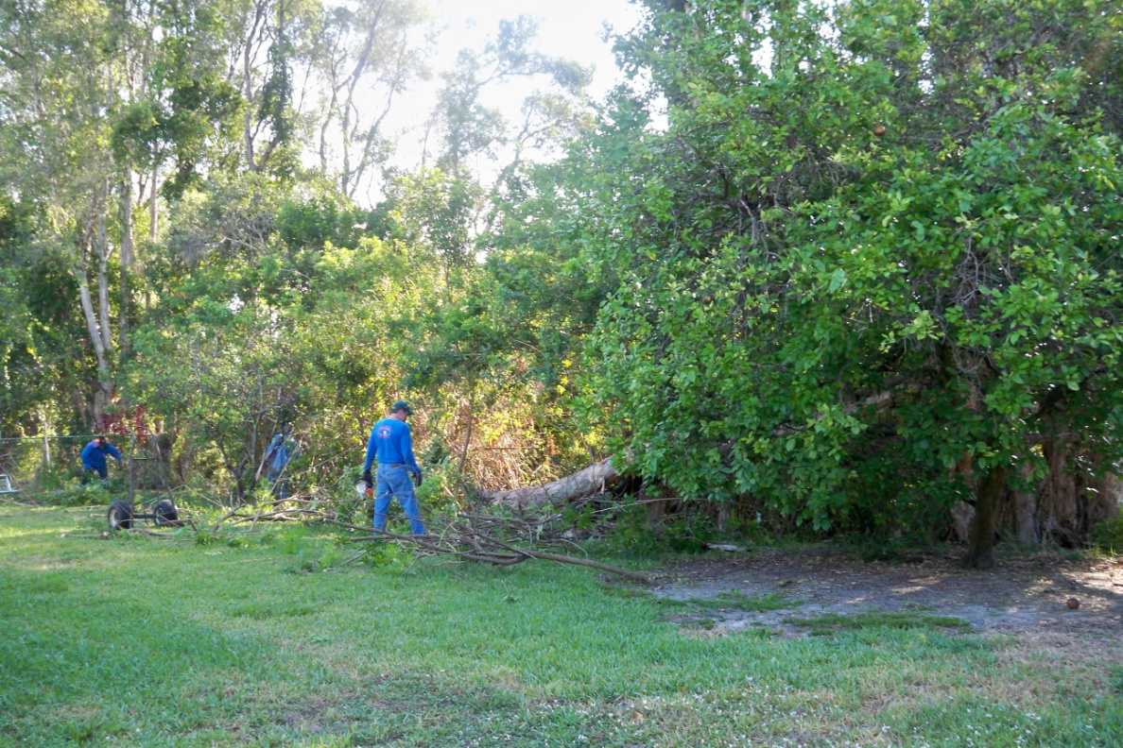
Mulloch Creek Habitat restoration pre-exotic removal

Slide 14
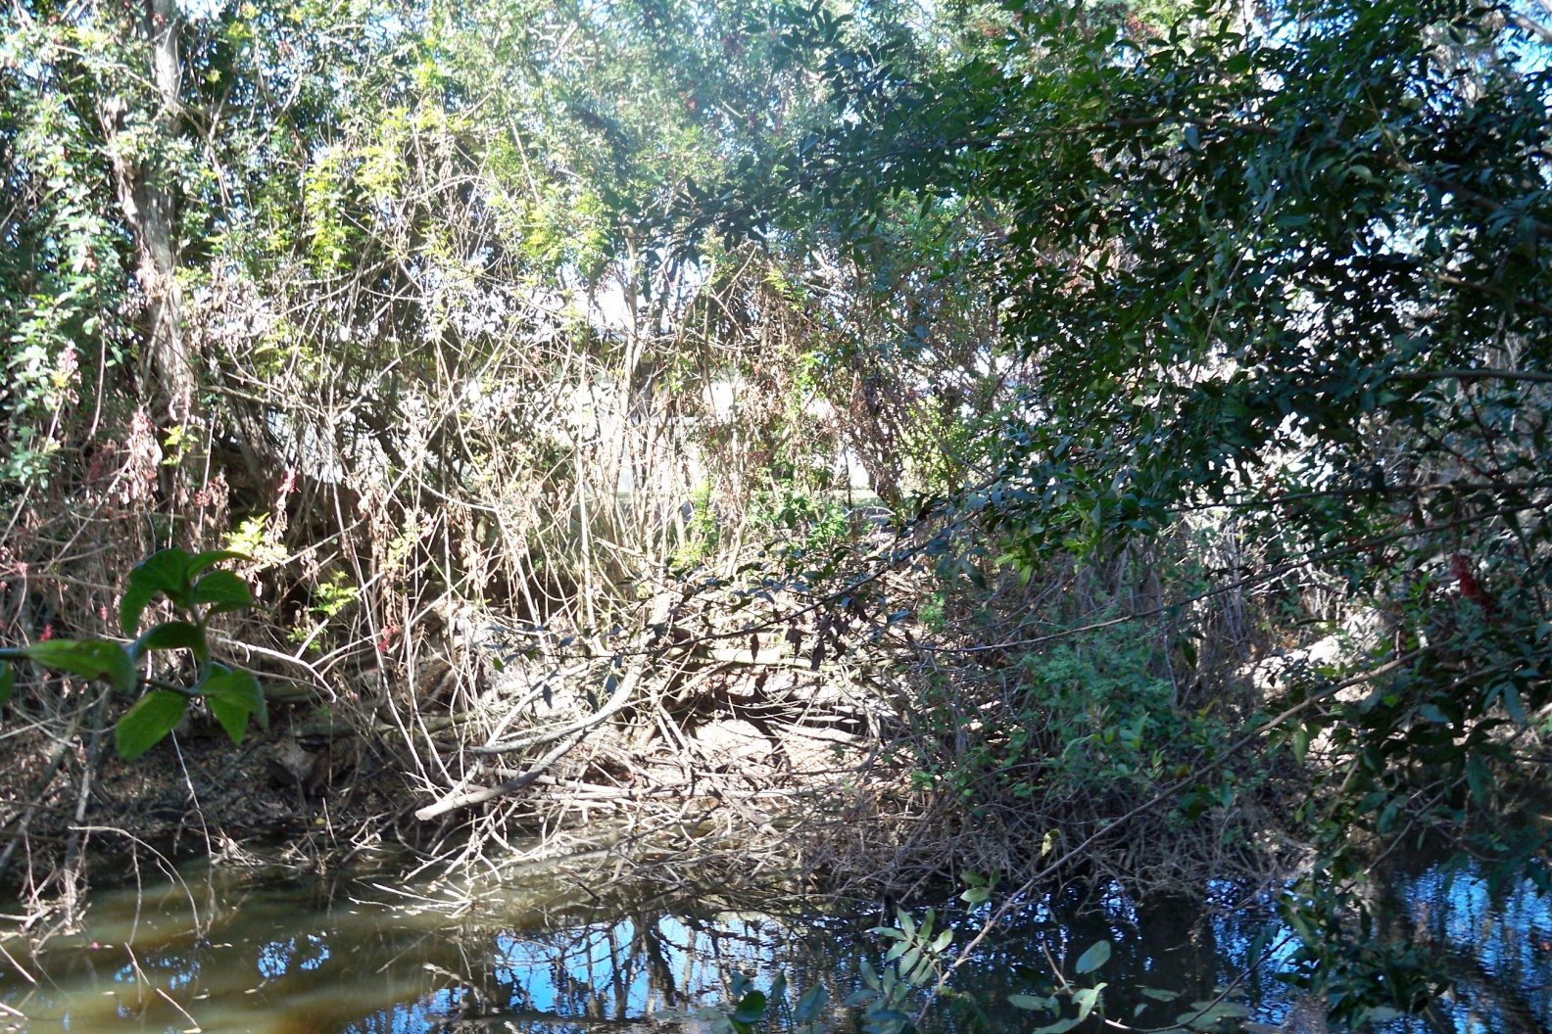
Exotics for removing

Slide 15
Exotic removal funded by EMDD

Slide 16
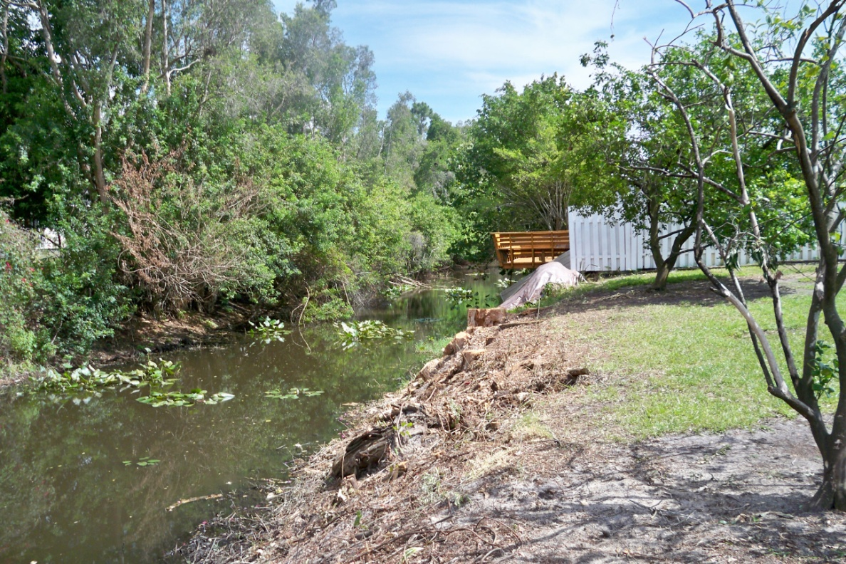
Exotics removed (Melaleuca and Brazilian pepper)

Slide 17
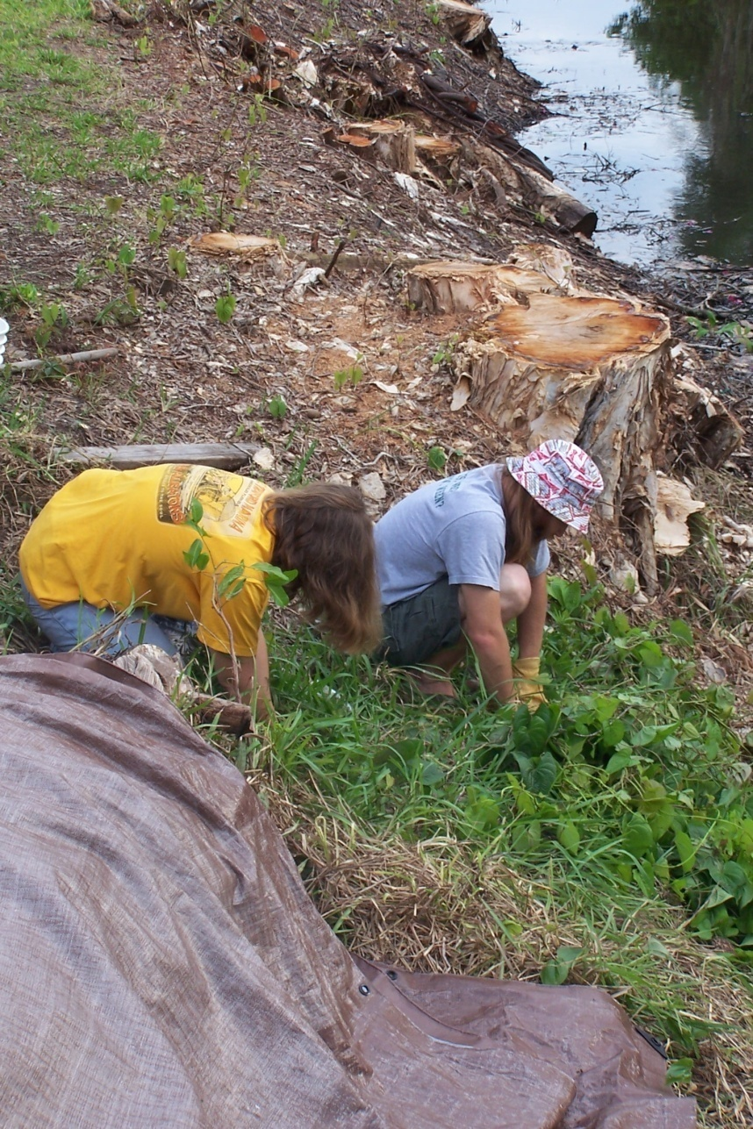
Air potato and exotic removal (cont’)
During Summer 2009
over 35 students and 350 Service learning hours contributed from FGCU Colloquium students

Slide 18
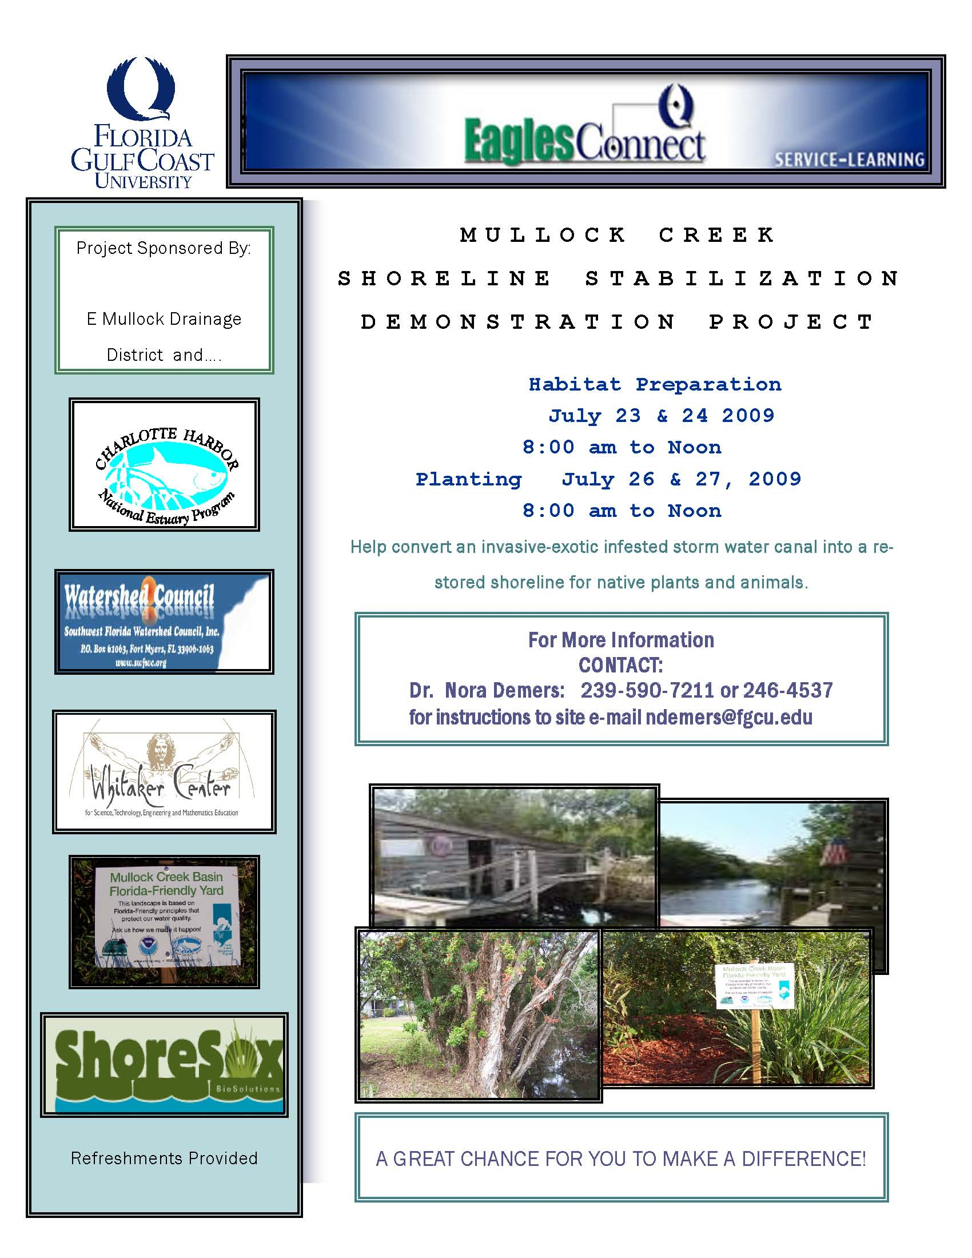
MULLOCK CREEK SHORELINE STABILIZATION DEMONSTRATION PROJECT help convert an invasive exotic infested storm water canal into a restored shoreline for native plants and animals

Slide 19
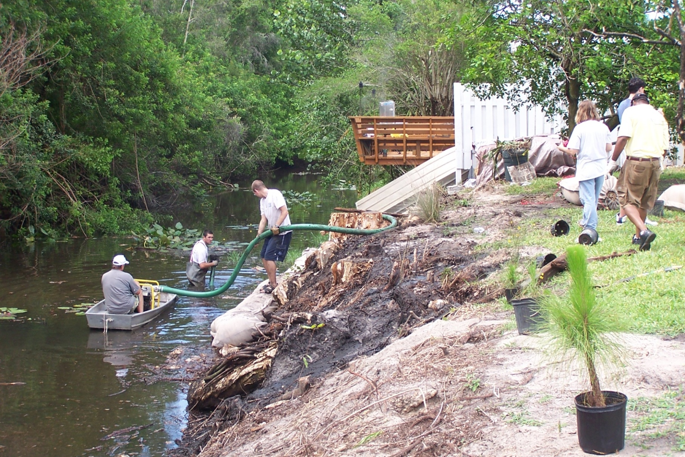
Work Day June 2009- pumping muck planting etc.

Slide 20
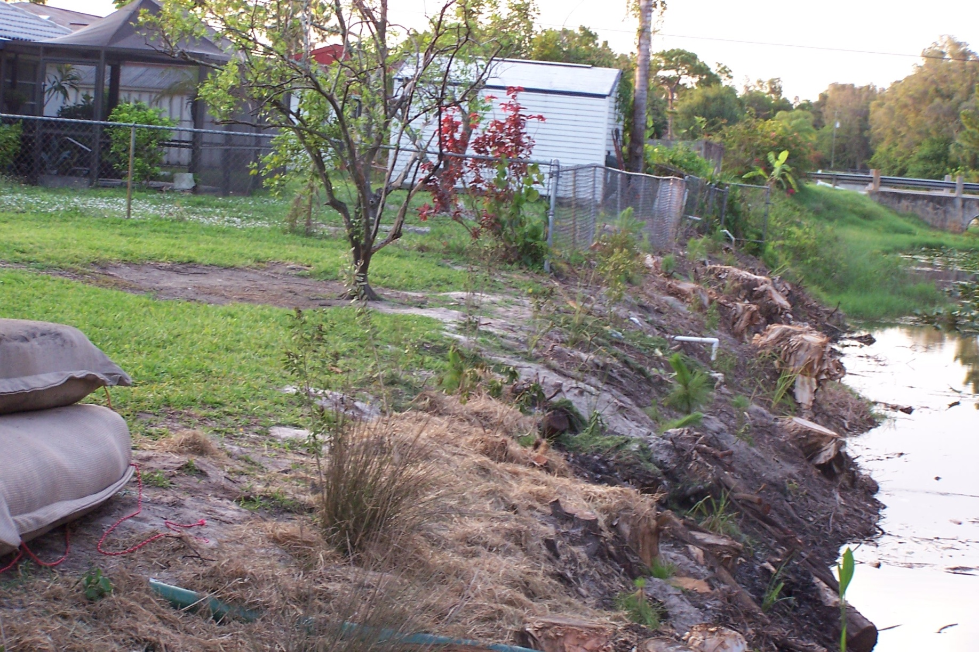
Native plantings from FGCU Arts Complex

Slide 21
The impact of course-based service-learning on ecological perspective and sense of place: Mulloch Creek Shoreline Restoration Project
Florida Gulf Coast University
University Colloquium
CRN 81257
Fall, 2009
Laurie Coventry-Payne, M. S.
Nora Demers, Ph.D.

Slide 22
Demographics of the class

Slide 23
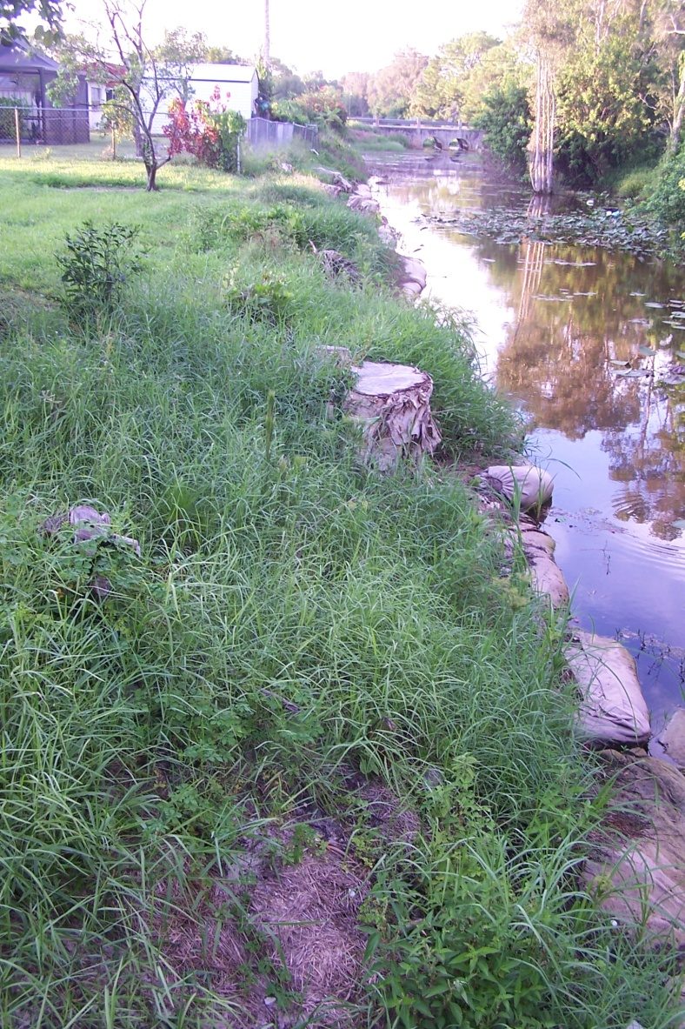
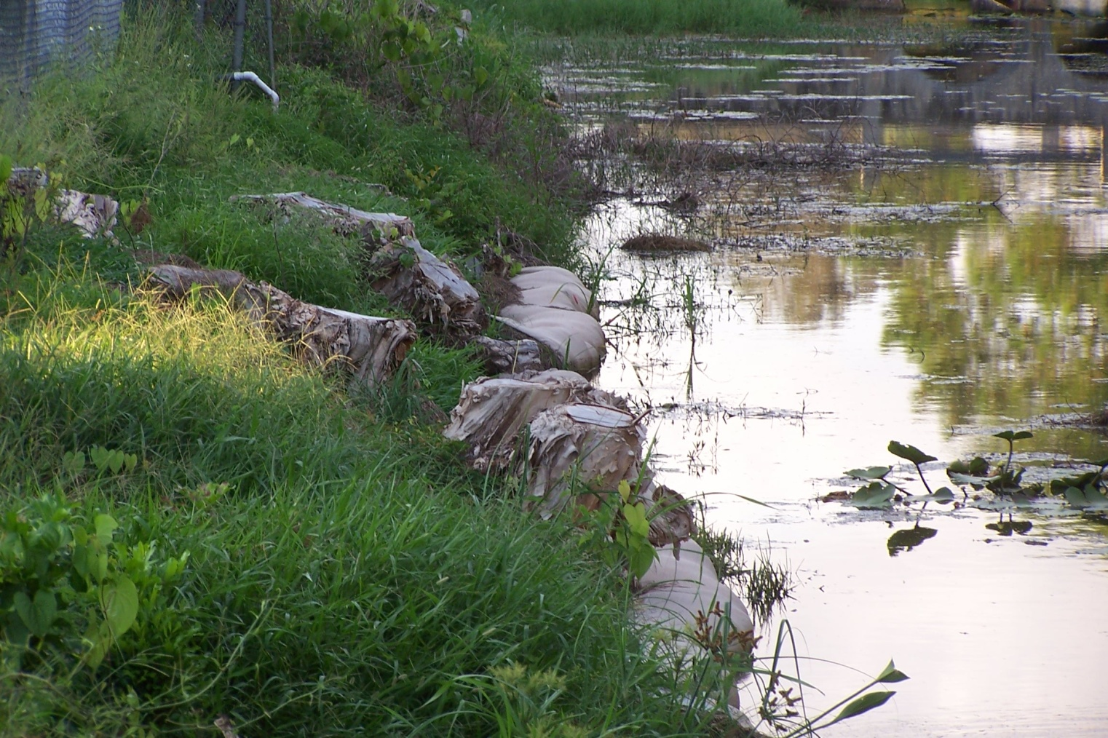
September, 2009 plant growth- note lack of (most) air potatoes!

Slide 24
October, 2009 Weed pulling and Planting of trees and shrubs
Charlotte Harbor National Estuary Program grant supported project including purchase of native plants from local nursery
Trees were donated from Division Of Forestry

Slide 25
Part of the crew

Slide 26
Pulling grass

Slide 27
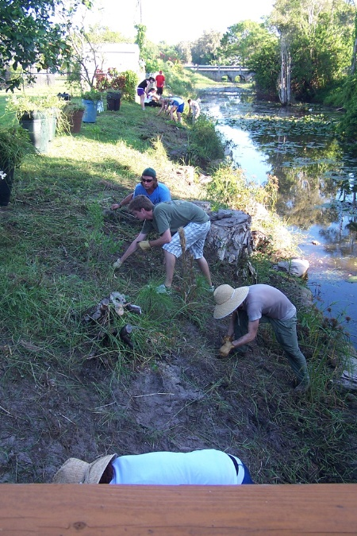
Teamwork!

Slide 28
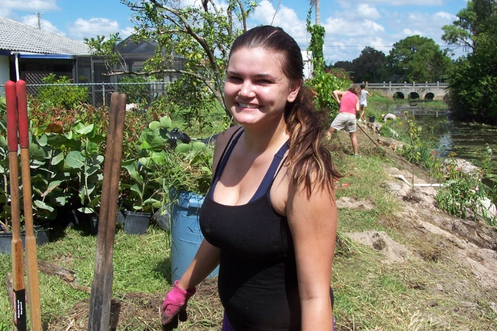
Hard workers

Slide 29
Plants arriving

Slide 30
Digging holes

Slide 31
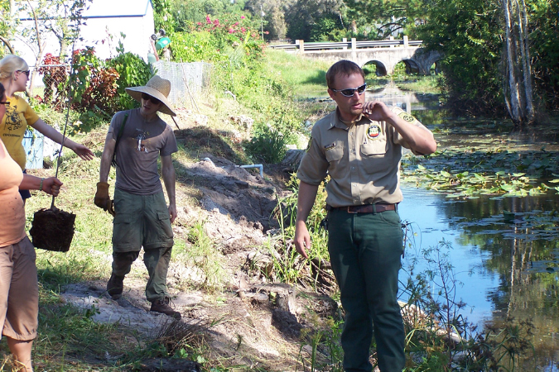
Learning from Mike Weston (DOF)

Slide 32
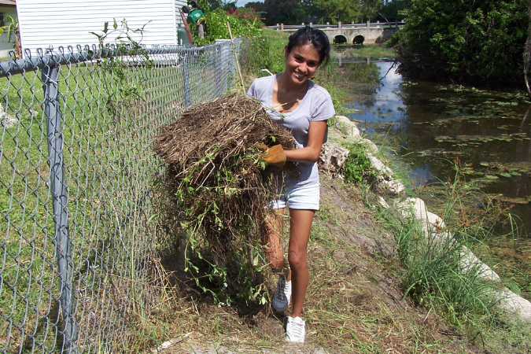
more grass pulled!

Slide 33
Diligently working

Slide 34
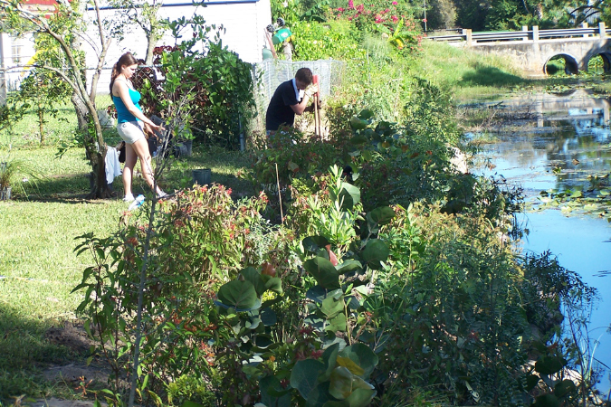
Almost done

Slide 35
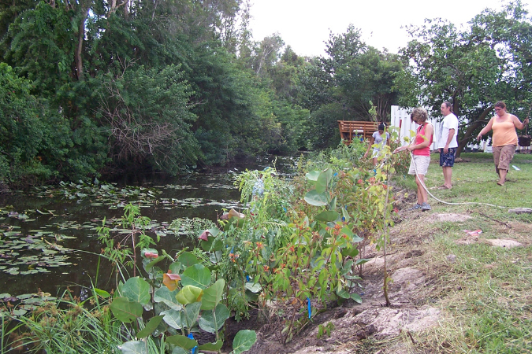
Looking good!

Slide 36
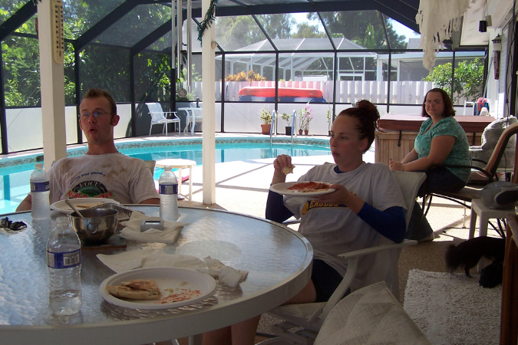
R&R was valuable time

Slide 37
Partner with Laurie Coventry-Payne’s Fall 2009 Colloquium class
How did students feel when first introduced to the project?
Mixed emotions
Overwhelmed
At first it was hard
It looked pretty ugly
The old website was very confusing
Full of weeds
Intimidated
Saw tons of work
I was in shock . . . no way
Looking forward to doing something difficult, meaningful and adventurous in this class
Personally anxious to get involved with something related to the environment
At first not sure why we were investing time and labor extracting exotic plants
I thought the project was ridiculous – why should I PAY to volunteer
At first I thought it was stupid

Slide 38
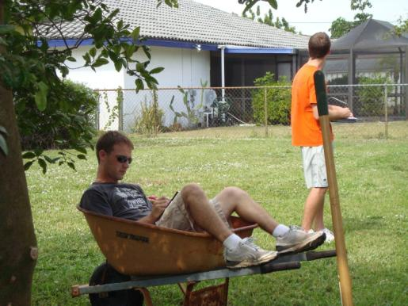
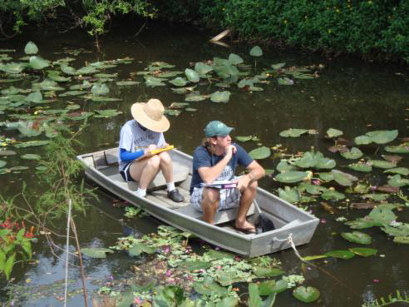
What did students feel they accomplished?
Took out the bad species – put in species that belong
[Created a] much needed visual aide for promoting the effort
Native plants and animals regain their homes
Now a better looking shore
We can see a huge difference in the ecosystem
Balances the ecosystem
Create[s] a better environment for locals
Begins new life
More native plants
What we did was only a start
We were able to see results
Less pollution

Slide 39
How did students feel after having completed the project?
Exceeded our goal
What our class did was great!
Every student should work on a project like this
Nice to see the before and after
We really helped make a difference
Nice to see the fruits of our labor
Enjoyed building the website
We were able to see results
A born-again rejuvenated environment
Very hard but rewarding
One of my favorite activities
Bonded our class together
Website unique

Slide 40
How did students feel after having completed the project?
Realized the importance of the project
Hours of reading and writing translated into action
Felt good to shovel the dirt, plant the trees and wipe the sweat off my brow
Personally felt it was pretty cool
Positive contribution to the environment
Amazing
Class prepared me to do the project
Enjoyed planning and taking out weeds
My hands were all tore up, my back was killing me, could hardly move the next day . . regardless we had fun

Slide 41
Did students feel the work they did is of lasting value?
Small step in a big picture
Will continue to serve
An example to others
Can influence and motivate future work
We really made a difference
Others will look at the website and want to get involved
Made a big difference
Am experience I will never forget
Project brought our class together
We relied on one another
A wonderful experience
Saw value in the work we did
Now a nice looking shore of native plants
Most rewarding time was this project
improved the health of the ecosystem

Slide 42
Did students feel the work they did is of lasting value?
Critical for the area
Will set an example of working together to achieve a healthier, greener community
We made a big difference
Hopefully when enough people have heard about [this] it will made a difference in human lives
For the people of Mulloch Creek, the Shoreline Restoration will remind them of the hard work one University Colloquium did in the fall of 2009
I hope the tree [I planted] spreads its seeds and grows 1000’sand 1000’s more trees along San Carlos Park
We returned to see the beauty of our masterpiece . . . it was amazing
It’s great to see little critters thriving in this area I call mine

Slide 43
What was the impact on students personally?
With one’s own hands improve[d] the environment
Felt good to be part of something that benefits the environment
Gave me a sense of place
Accomplished
Made me feel more a part of nature
Made me want to invest all my time and energy into preservation of the environment
Reinforced what I learned
Rewarding
Made lifelong friends
Never paid attention before, now more aware
Influenced me to contribute
Improved my sense of place

Slide 44
What was the impact of the project on students personally?
More in touch with the outdoors and nature
Made me want to do more
Taught me about all the different trees and plants
Got to use my art to help people
The class gave me the tools to get the job done
Solidified my sense of place . . . brought that sense of place into sharper focus
Fulfilling
Somewhere along the way, I found something I hadn’t been asked to use publically in a long time: my mind

Slide 45
Student-created website some testimonials
http://clubs.fgcu.edu/SanCarlosHabitatRestoration/testimonials.html
Jessica Garcia "I really enjoyed watching the butterflies and the simple satisfaction of a cool breeze and icy cold water on a hot day; most importantly though, I enjoyed helping my community. Planting native plants along the Mulloch Creek gave me a sense of accomplishment."
Linsey Kouns "This experience made me feel good about myself. I genuinely felt like I was making a difference in my community." Maggie Jo Rodocker "While working on the project it brought me closer together with both my classmates and environment. It gave me a greater appreciation of the beautiful state of Florida and I encourage anyone to take on a similar venture."
Ron Angerer "Our efforts at Mulloch Creek will live beyond our years and the years of the people who live in that neighborhood, and the lasting impact our work in 2009 will have is truly incredible. This activity was truly a case of “Thinking Globally, Acting Locally.”

Slide 46
STUDENT UNDERSTANDING OF COURSE-BASED SERVICE LEARNING INCREASED OVERALL AFTER UNIVERSITY COLLOQUIUM

Slide 47
STUDENT SELF-REPORTS ON PERSONAL COMMUNITY AWARENESS AND INVOLVEMENT

Slide 48
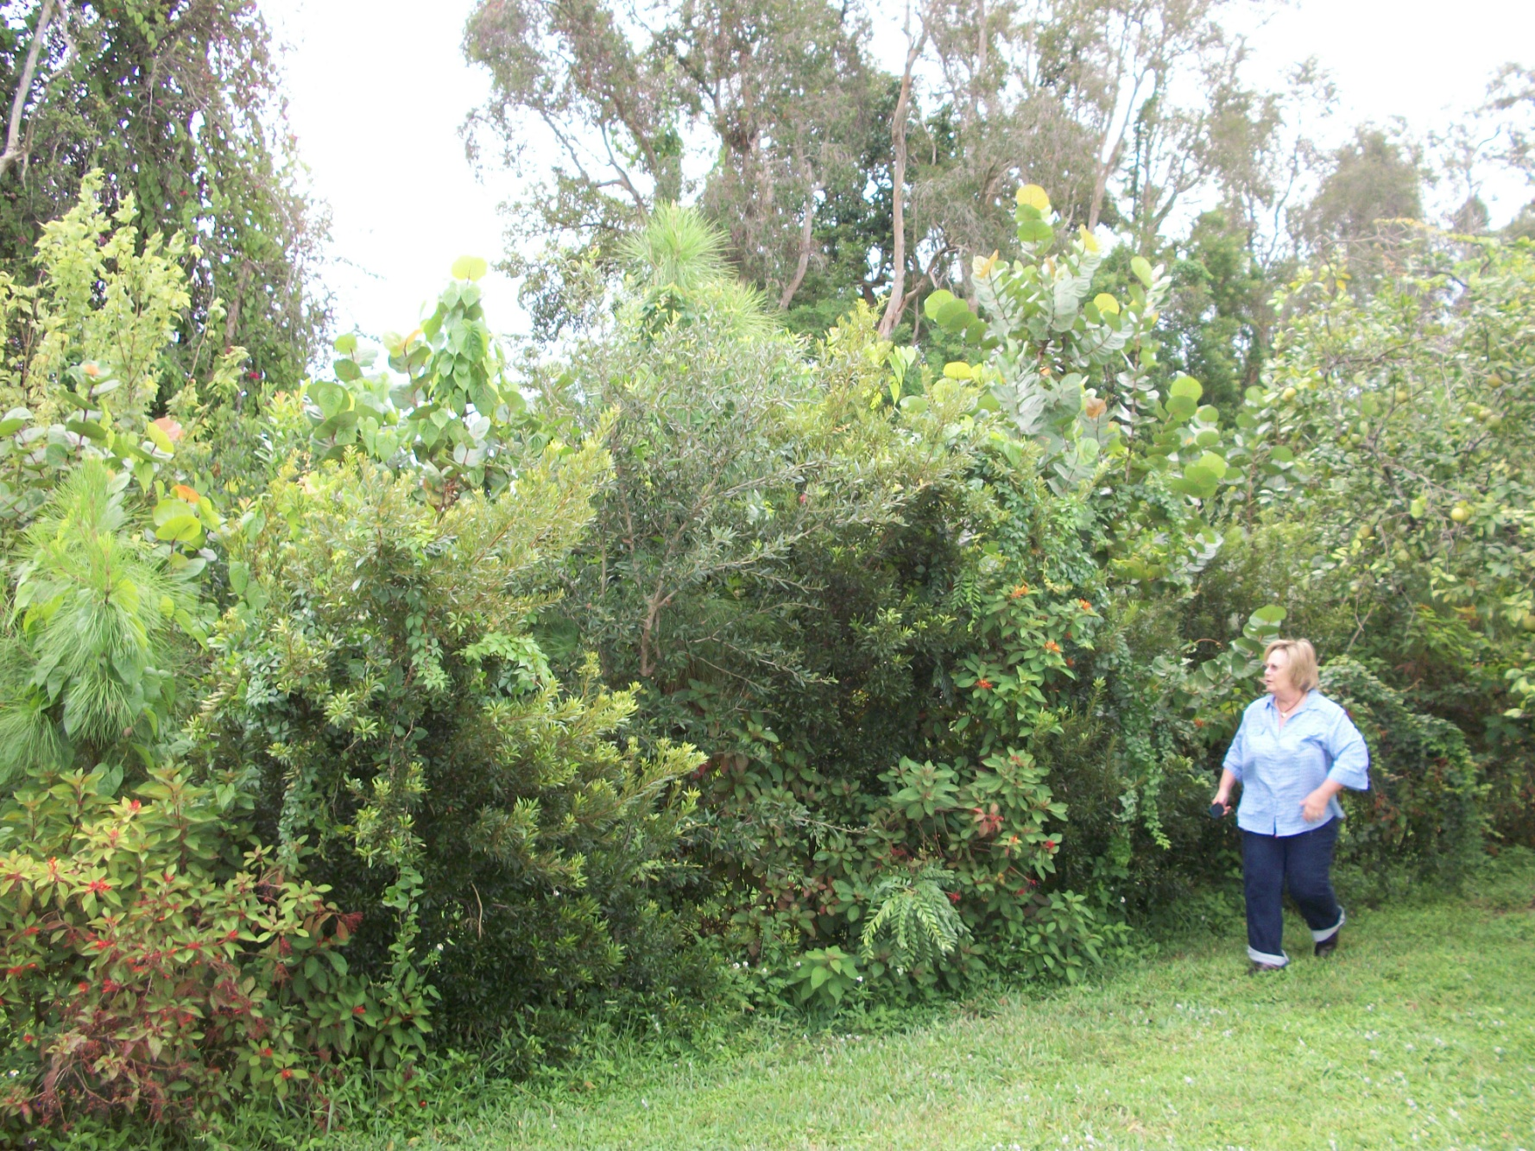
2012 update

Slide 49
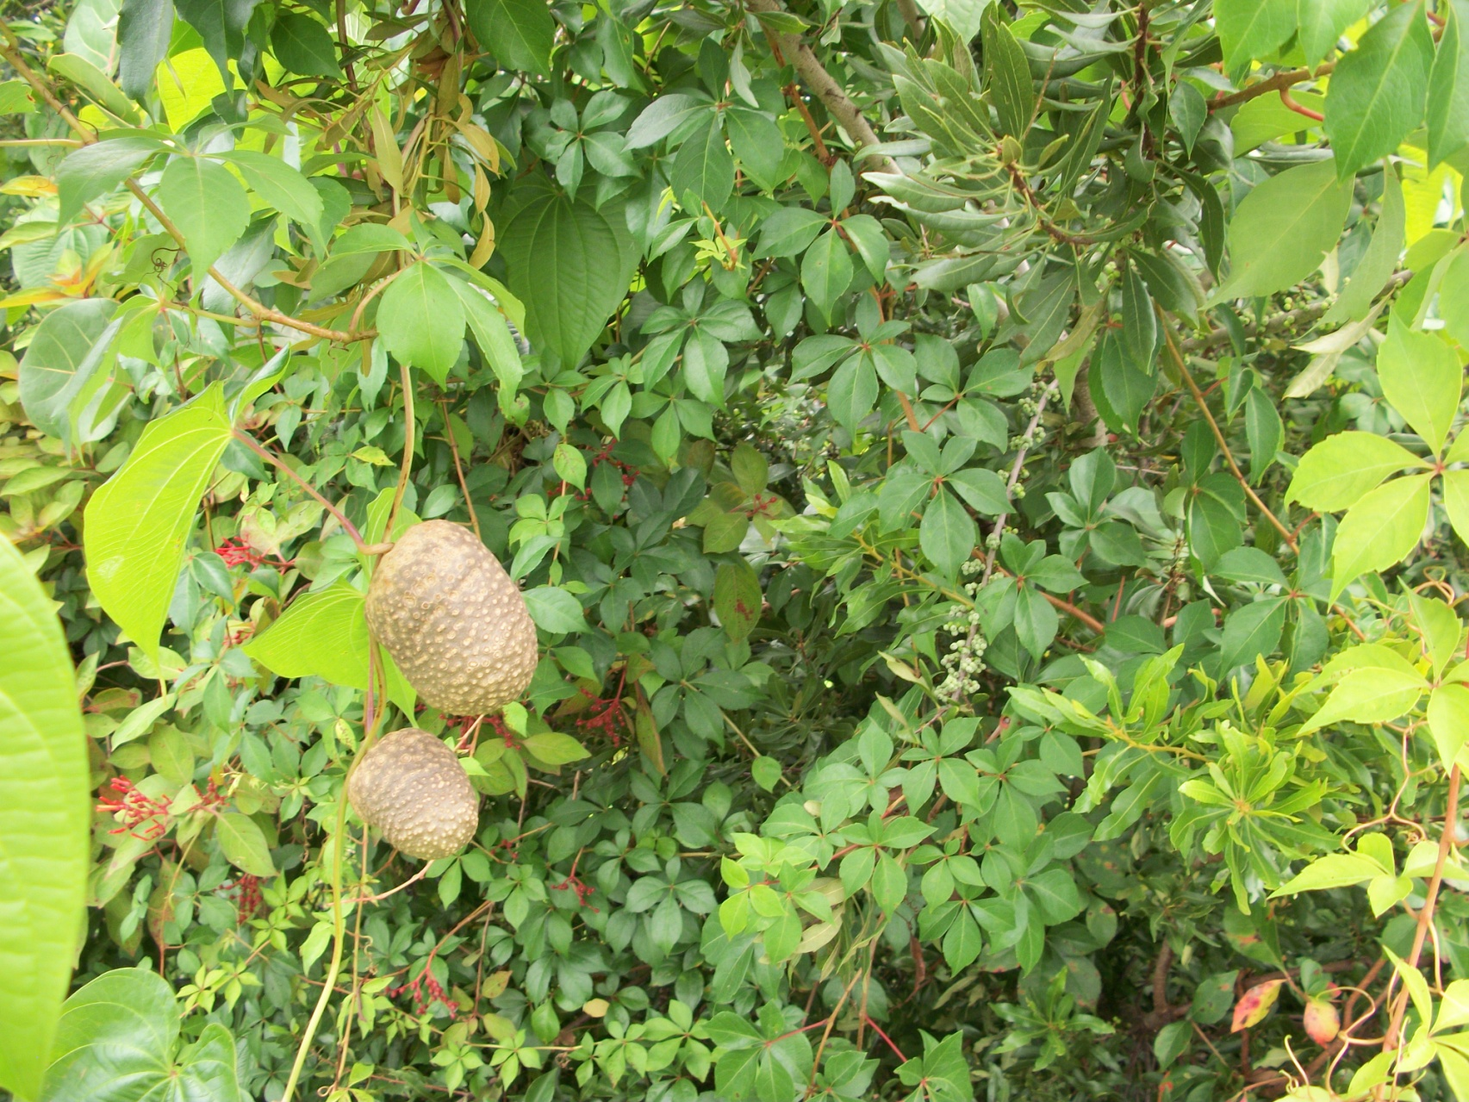
2012 air potatoes war continues

Slide 50
2012 Env. Bio. SWF Maintenance
SENCERIZED walk down the watershed with Professor David Green’s class.
Several groups of 4-5 Freshmen with different partners along the watershed.

